Slide 1
RESPECT
예찬호 육수림 이수정
https://github.com/GC-RESPECT/R.E.S.P.E.C.T
Notes:
현실감있는 경험 공유 플랫폼, 쉽게 연결되는 장비

Slide 2
Introduction
Related Work
Proposed Method
Implementation
System Configuration Diagram
Sensor Part
Video Playing Part
Server Part
Marketing Plan
Role
Contents

Slide 3
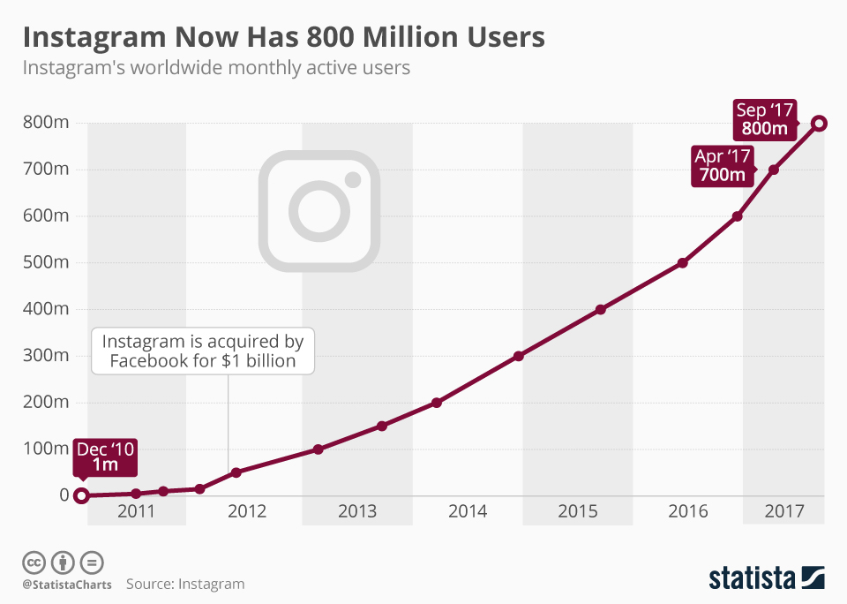
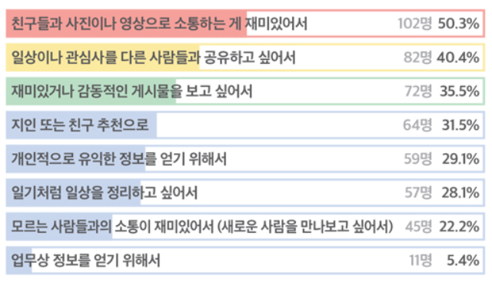
Introduction
Sharing
Communication
statista
Digital inside media
Increasing number of SNS users
Why? To share their experience
Notes:
https://www.statista.com/chart/9157/instagram-monthly-active-users/
http://www.ditoday.com/articles/articles_view.html?idno=18544

Slide 4
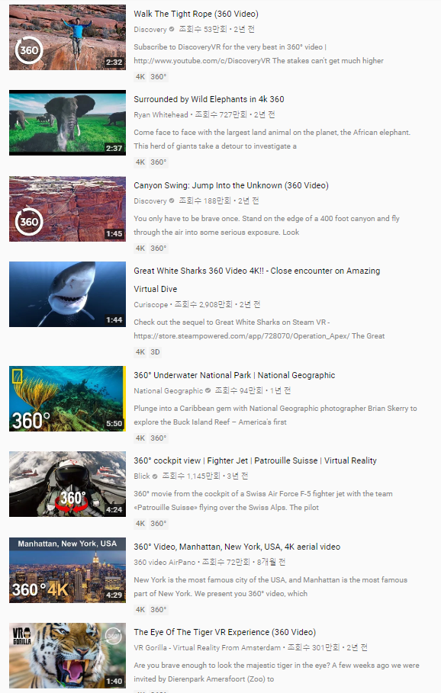
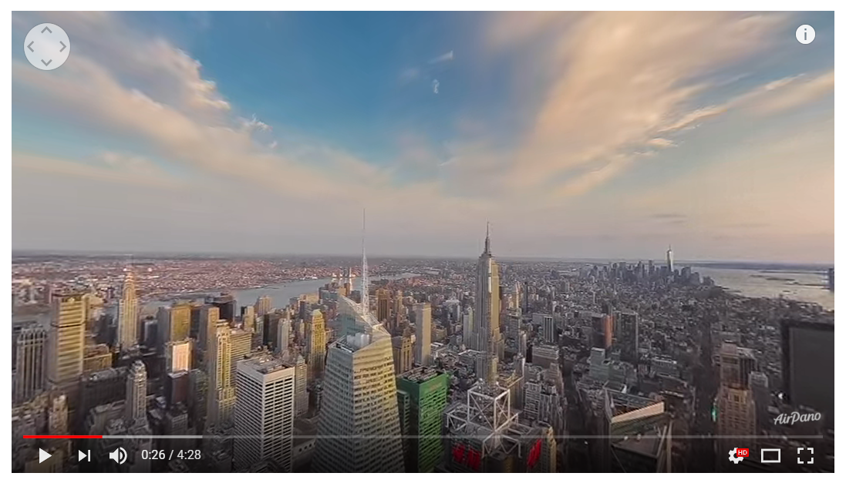
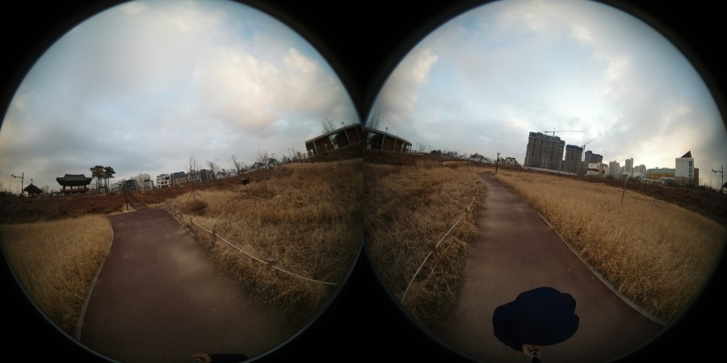
Introduction
Video content taken with dual cameras or 360-degree cameras is increasing to record realistic experiences
Various applications supporting navigation
are developed in the web or virtual environment
Notes:
https://post.naver.com/viewer/postView.nhn?volumeNo=7088765&memberNo=724

Slide 5
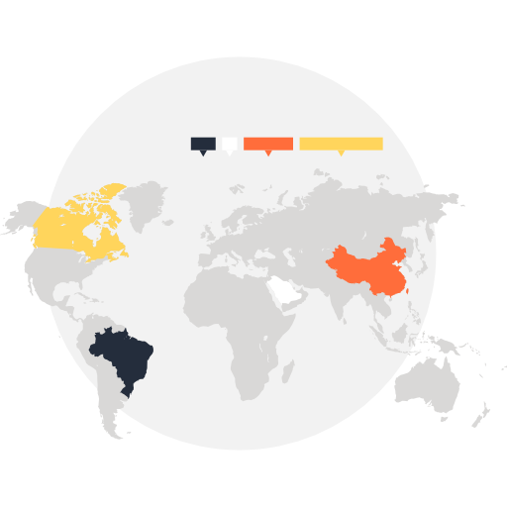




Introduction
Sharing memory
360 camera
VR
Sensor-based 360 video walk-in-place navigation in VR
Notes:
Realistic experience-sharing platform with VR

Slide 6
Related Work
[Related works]
360 video navigation, virtual environment
- Google Earth provides
VR contents and 360 video navigation
Google Earth
[Limitation]
Lack of natural navigation method
- User needs to click the forward button
in a similar way of road view
Google Earth

Slide 7

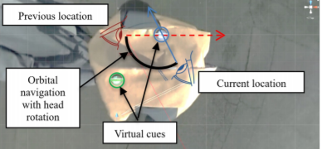
Related Work
[Related works]
360 video navigation, virtual environment
- Navigation based on eye movement and head direction information in virtual environment
[Limitation]
Different navigation method from the way people move in real life

Slide 8

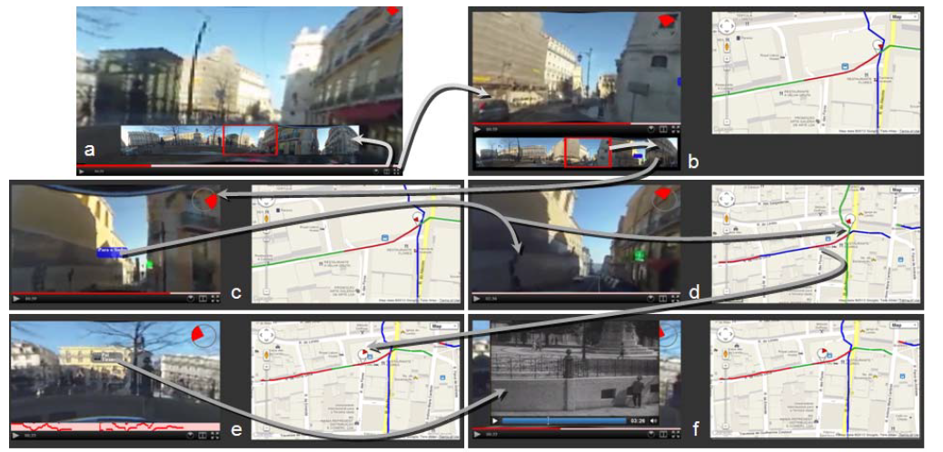
Related Work
[Related works]
360 video navigation, web
- Navigation based on mouse and keyboard input of user in the web
[Limitation]
Limited video playback speed
Can’t provide intuitive navigation to users
Mindtrek , 2012

Slide 9
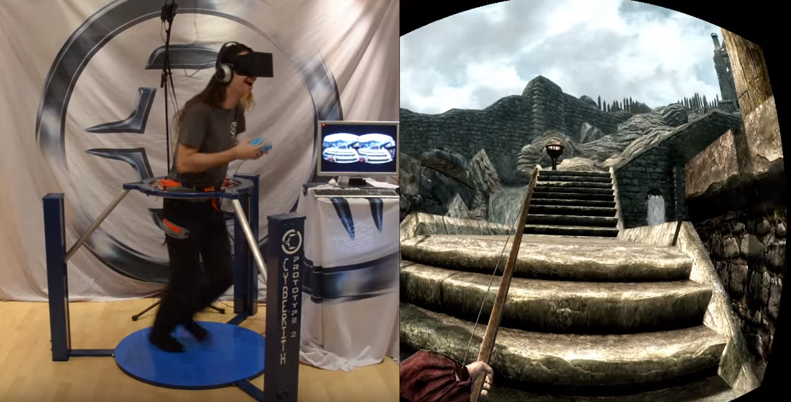
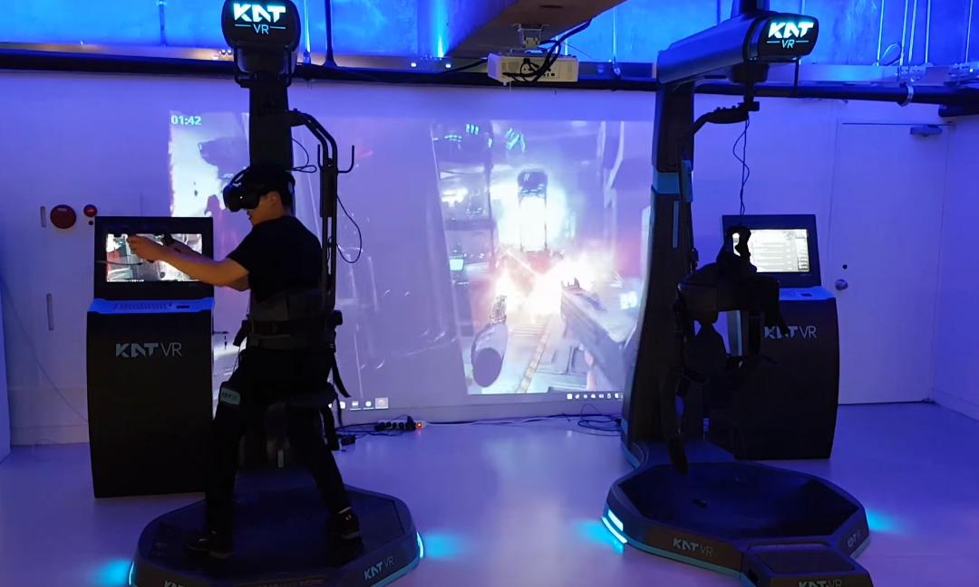
Related Work
Cyberith, 2014
The NEW Infinadeck-CES 2016
KAT VR
[Related works]
navigation platform for walking
- User can enjoy playing
with movements
[Limitation]
- Huge & expensive
equipment is required
- Difficult to enjoy in home

Slide 10
Proposed Method
Lack of natural interaction
for navigation
Provide natural walking navigation method
Restrictions of movement
Huge and high cost equipment
Use only phone and HMD
Sensor-based 360 video walk-in-place navigation in VR

Slide 11
Proposed Method
시속 6.2km
거리 1.3km
The user puts on the HMD and then walks in place.
The path that the user has moved is recorded on the map.

Slide 12
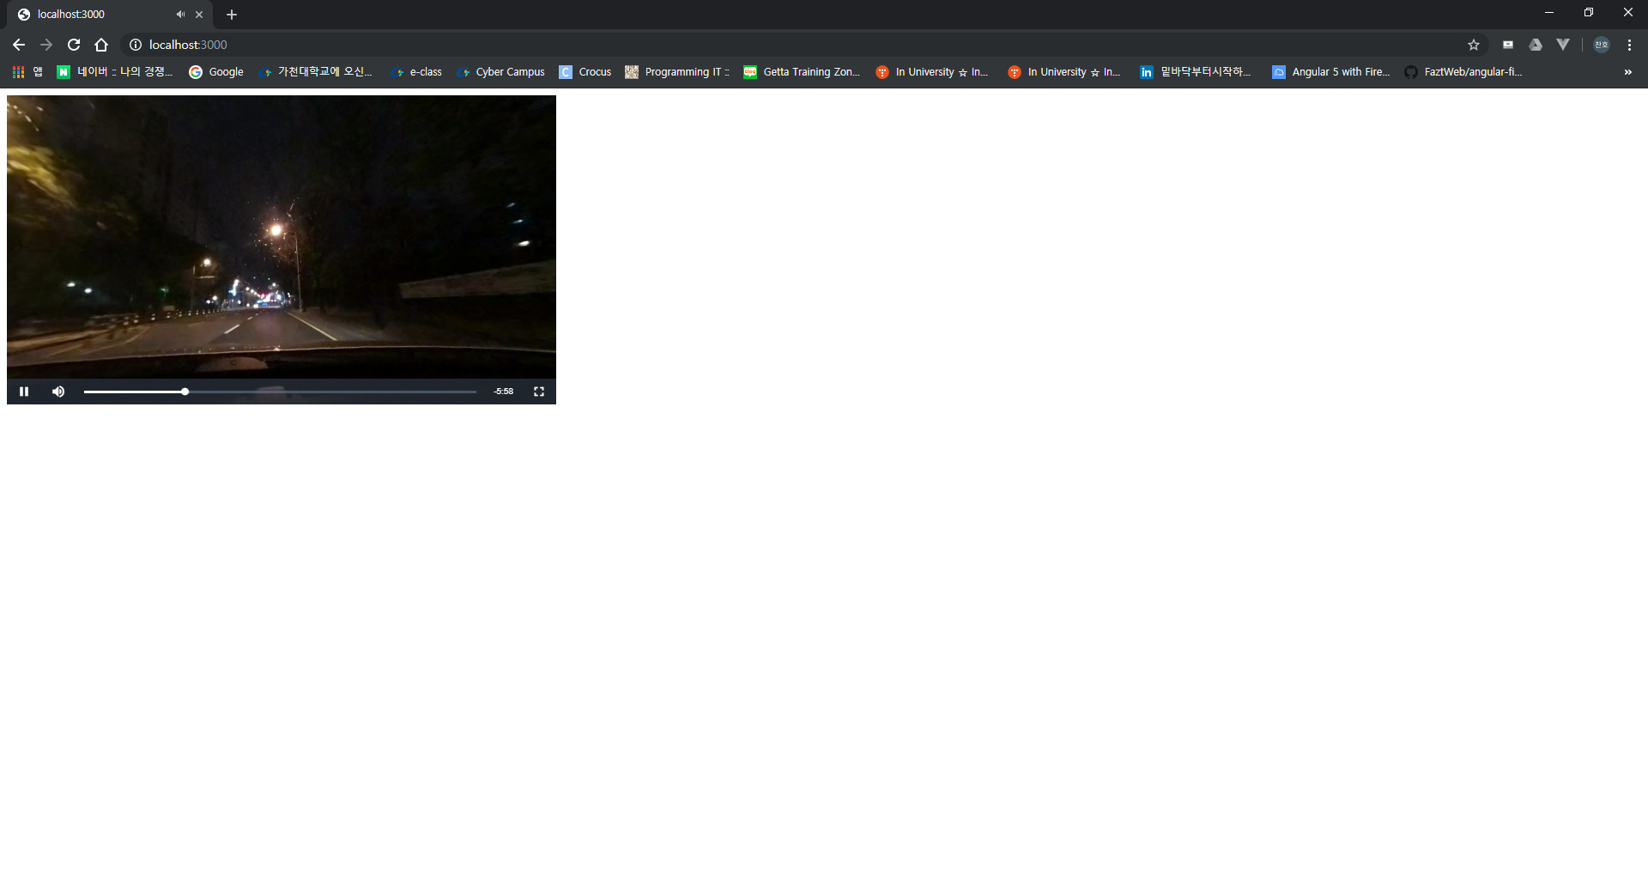
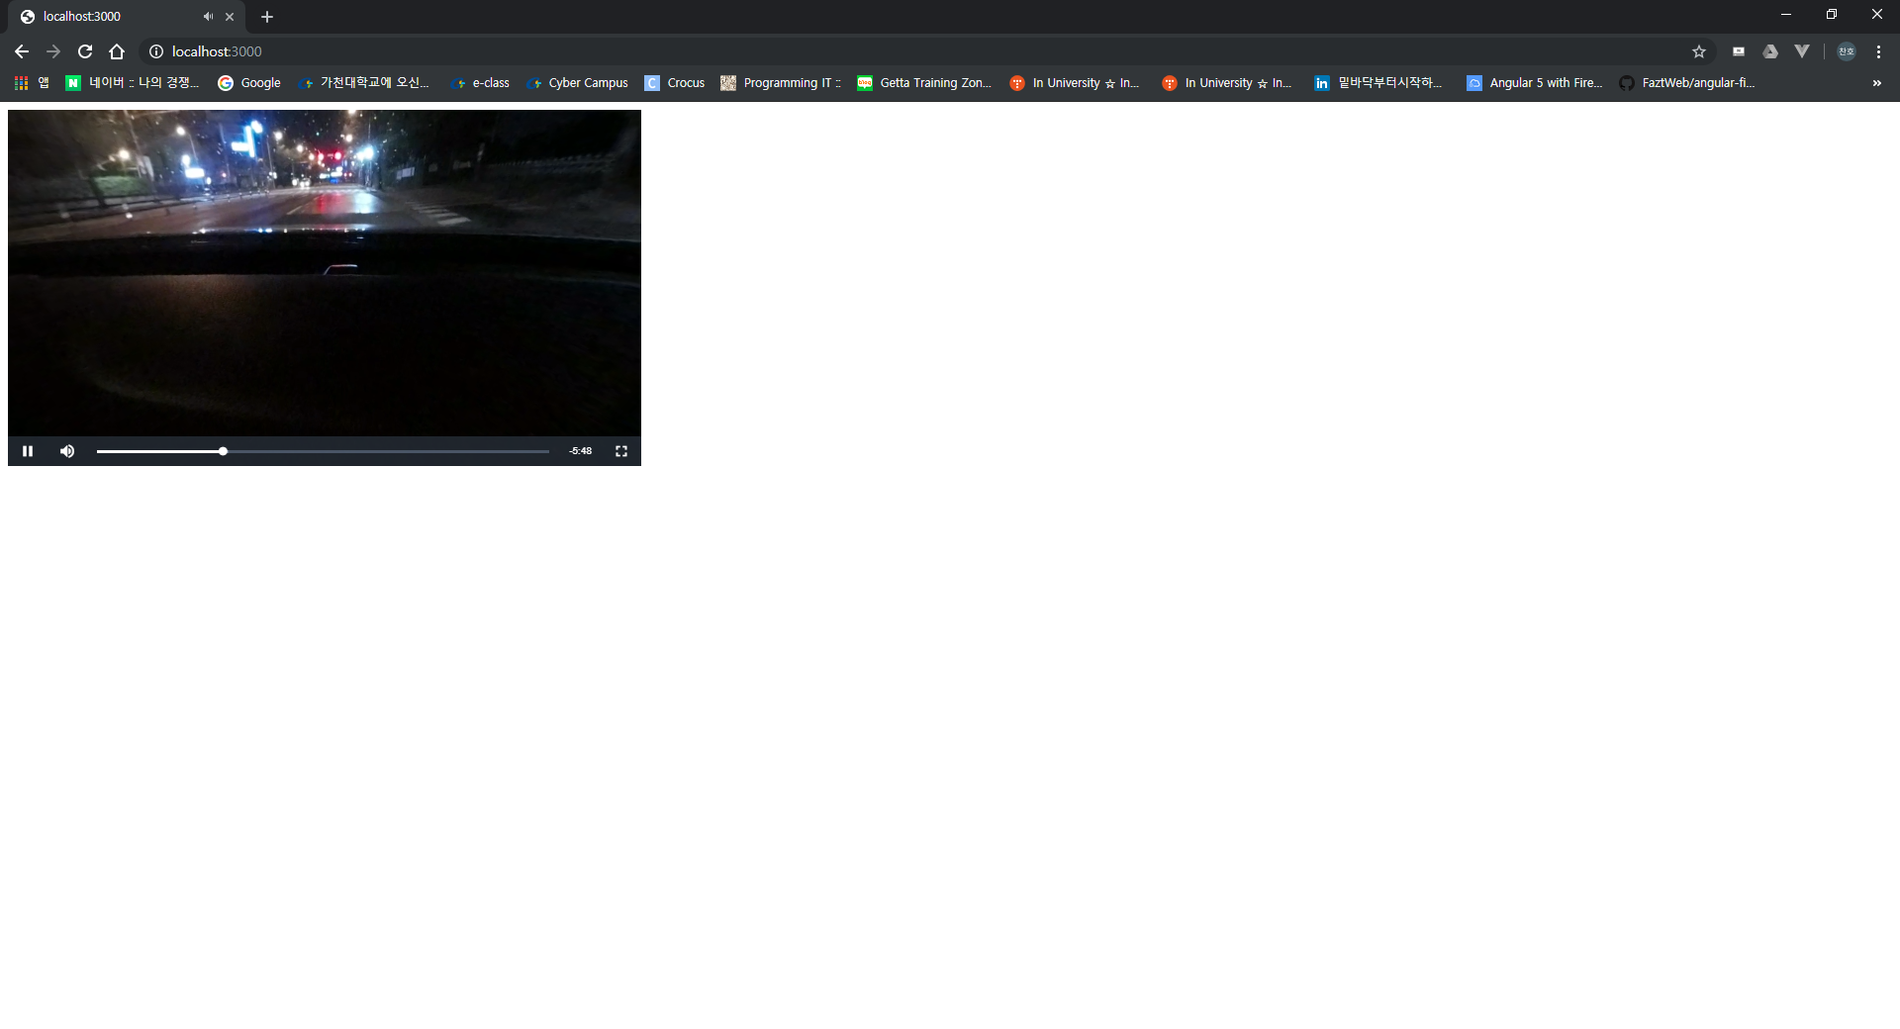
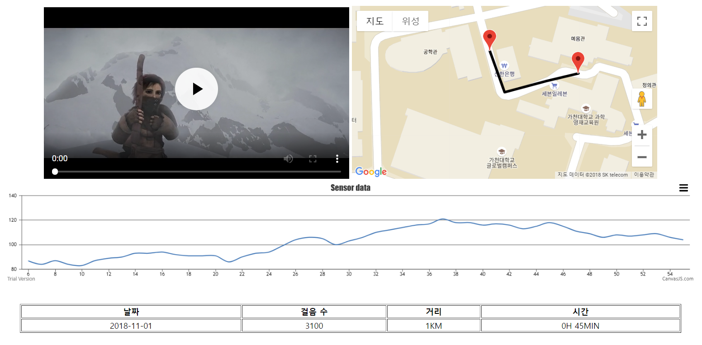
Proposed Method
Users can view the scenes and information they have experienced on the Web.

Slide 13




System Configuration Diagram
1
Sensor Part
2
Video Playing
Part
Signal processing(Filtering)
Feature extraction
Analysis algorithm
Distance
Velocity
Direction
Calculate
Image parameters
Collect sensor data
(acceleration/gyro)
Route tracking
Sensor information
Video time stamp
Time stamp + GPS
360 video database
3
Server Part
Play 360 video using playing speed and vision

Slide 14
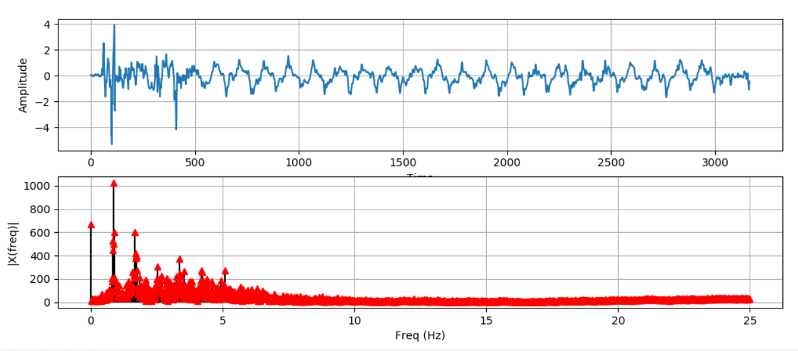
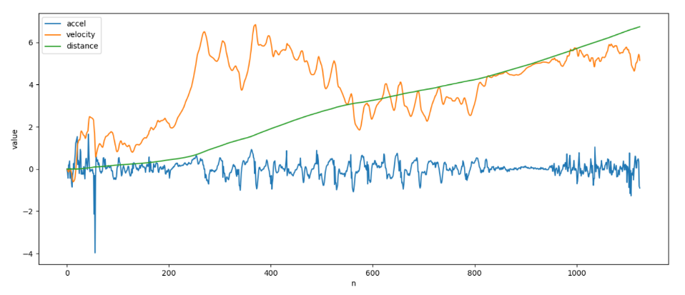
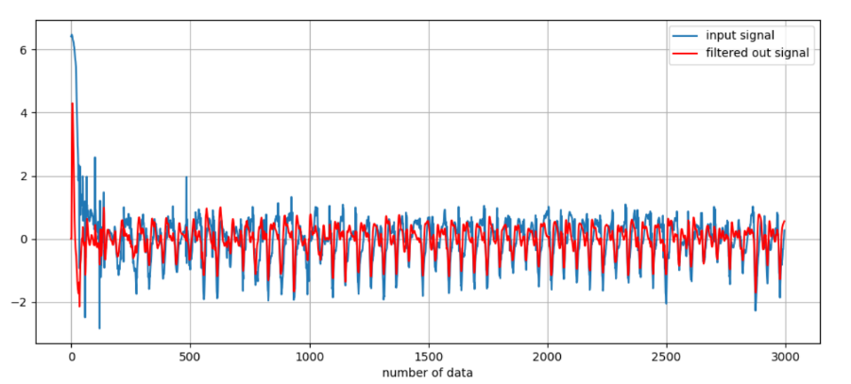
Sensor Part
1
Get acceleration sensor data in 50Hz
FFT
(Find filter frequency)
Compute distance
and velocity
Low pass filter
Apply low pass filter based on 5 Hz
Obtain speed and distance through integral and double integral.

Slide 15
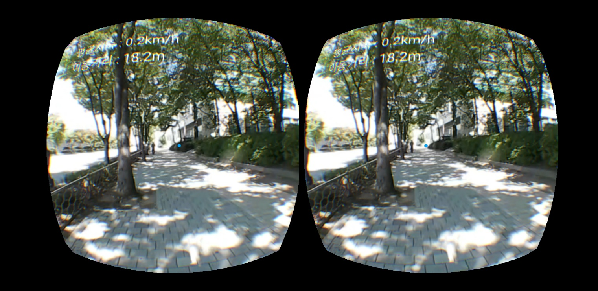
Video Playing Part
2
Load 360 video
and GPS data
Get velocity, distance,
rotation of head from sensor
Change playback
speed and orientation
Pseudo Code
procedure onSensorChanged
if step_detected is true then
set velocity, distance to calculateSensorValue
set playback_speed to velocity
set velocity_text to velocity
set distance_text to distance
send rotation of head to server
end
HMD – Gear VR
Environment – Android 8.0(Oreo)

Slide 16
Server Part
3
Sensor
information
Sensor information
Tracking moving route
Record moving route using step information calculated by sensor information and GPS information matched with time stamp.
Video
time stamp
Time stamp
GPS
Video DB
Video
Server – AWS
Database – firebase
User can check the moving route and information in web and application

Slide 17



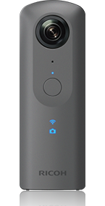

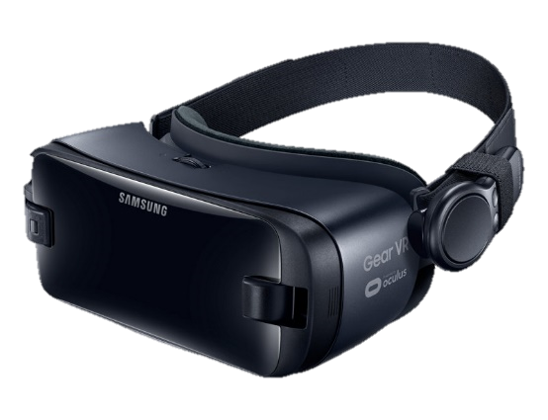

Implementation
[Devices]
[Tools]
Android device (Galaxy Note 8)
- Version : 8.0(Oreo)
360 Camera
Gear 360
Ricoh Theta
HMD (Gear VR)

Slide 18
Marketing Plan-SWOT
STRENGTHS
WEAKNESSES
User can upload and share 360º video, it can be used like SNS.
So user can see more various contents compared to existing VR navigation applications.
Securing early users can be difficult.
Individual users must have their onw personal HMD.
S
W
O
T
OPPORTUNITIES
THREATS
There are predictions that AR markets will be bigger than VR markets.
There will be less investment in VR than AR.
Along with the increase of 5G, there is growing interest in VR contents from various telecommunication companies.

Slide 19
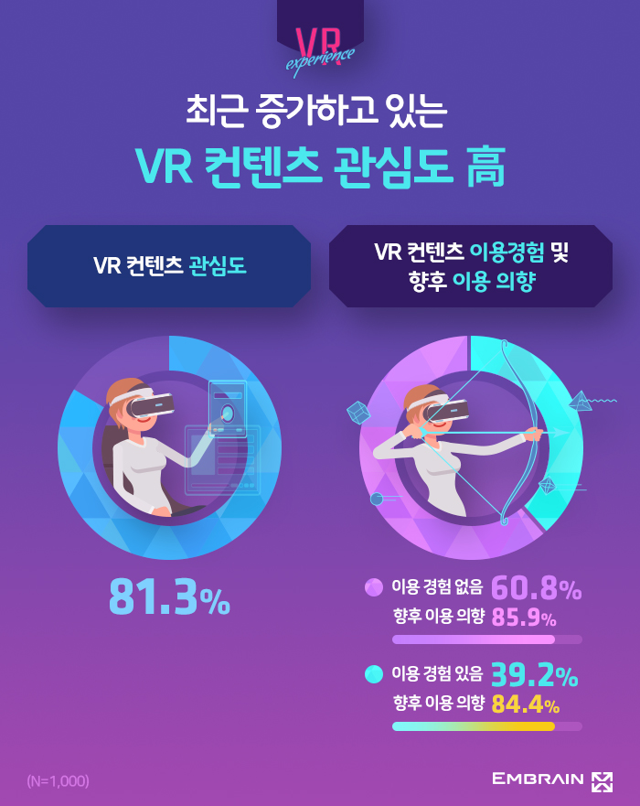
Marketing Plan
80.5%
70.9%
54.0%
40.1%
20s
30s
40s
50s
Interest in VR was high among people of low age.
Notes:
https://www.hankyung.com/it/article/201810079375Y
https://www.trendmonitor.co.kr/tmweb/trend/allTrend/detail.do?bIdx=1709&code=0101&trendType=CKOREA
만19∼59세 1천명을 대상으로 조사한 결과 81.3%가 'VR 콘텐츠에 관심이 있다’
20대 80.5%, 30대 70.9%, 40대 54%, 50대 40.1% 등 낮은 연령층에서 VR 게임에 대한 관심이 높았다"고 설명했다.

Slide 20
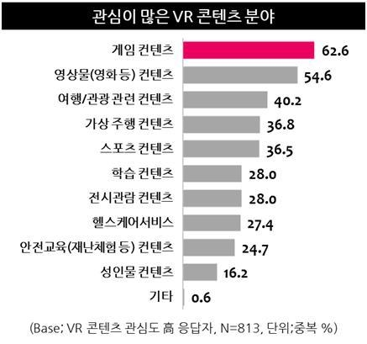
Marketing Plan
Many people are interested in travel relevant contents.

Slide 21

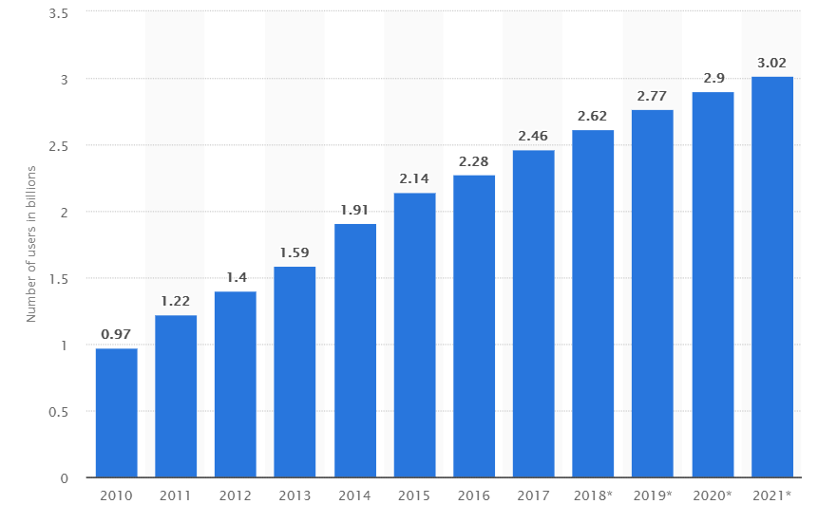
Marketing Plan
The number of SNS users is steadily increasing.
Statista, 2019

Slide 22
Marketing Plan
[Target]
People interested in new technology like VR
Young age group
People who like to share various experiences, such as their travels, on social media
Notes:
타겟
VR이라는 신기술에 관심이 있는 사람들
젊은 연령층
SNS에 자신의 여행 등의 다양한 경험을 공유하기 좋아하는 사람들

Slide 23
Marketing Plan
[Expected return]
Receive a fee by adding a certain amount to shared contents.
Profit from connecting to telecommunication businesses or companies interested in 5G
Notes:
예상 수익
공유 컨텐츠에 일정 금액을 붙여서 수수료
5G에 관심을 갖는 통신사나 기업 등에 연결하여 수익을 얻는다

Slide 24
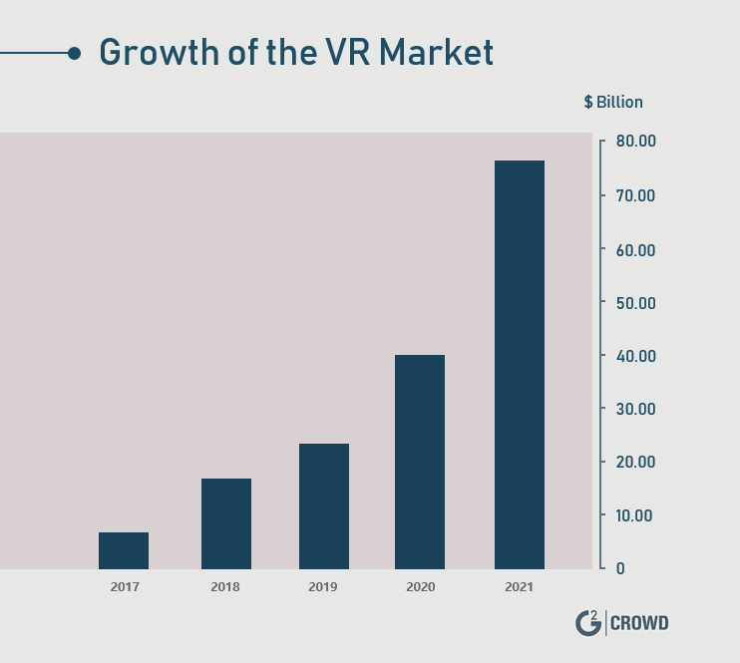
Marketing Plan
[Profit expectations based on growing number of users]
The number of users will increase with VR market growth
Expected revenue will increase with the increasing number of users.
Notes:
예상 수익
공유 컨텐츠에 일정 금액을 붙여서 수수료
5G에 관심을 갖는 통신사나 기업 등에 연결하여 수익을 얻는다

Slide 25



Role
Ye Chan Ho
Yuk Su Rim
Lee Su Jeong
VR navigation
Video streaming from server
Detecting user’s movement
(speed, distance, orientation, GPS)
Trajectory tracking
Showing info about experiences
Server
Database
Web
Notes:
Trajectory tracking:경로 추적

Slide 26
Github
https://github.com/GC-RESPECT/R.E.S.P.E.C.T
Notes:
Trajectory tracking:경로 추적

Slide 27
Thank
you

